Slide 1
Kingdom living Lesson 1

Slide 2
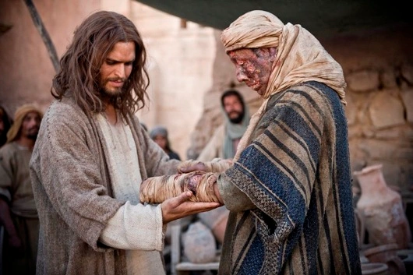

Slide 3
The Gospel of Matthew Chapter 8
1 When Jesus came down from the mountainside, large crowds followed him. ² A man with leprosy^{[a]} came and knelt before him and said, “Lord, if you are willing, you can make me clean.”
³ Jesus reached out his hand and touched the man. “I am willing,” he said. “Be clean!” Immediately he was cleansed of his leprosy. ⁴ Then Jesus said to him, “See that you don’t tell anyone. But go, show yourself to the priest and offer the gift Moses commanded, as a testimony to them.”

Slide 4
Poor in spirit

Slide 5


Slide 6
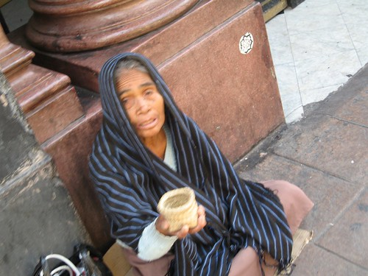


Slide 7
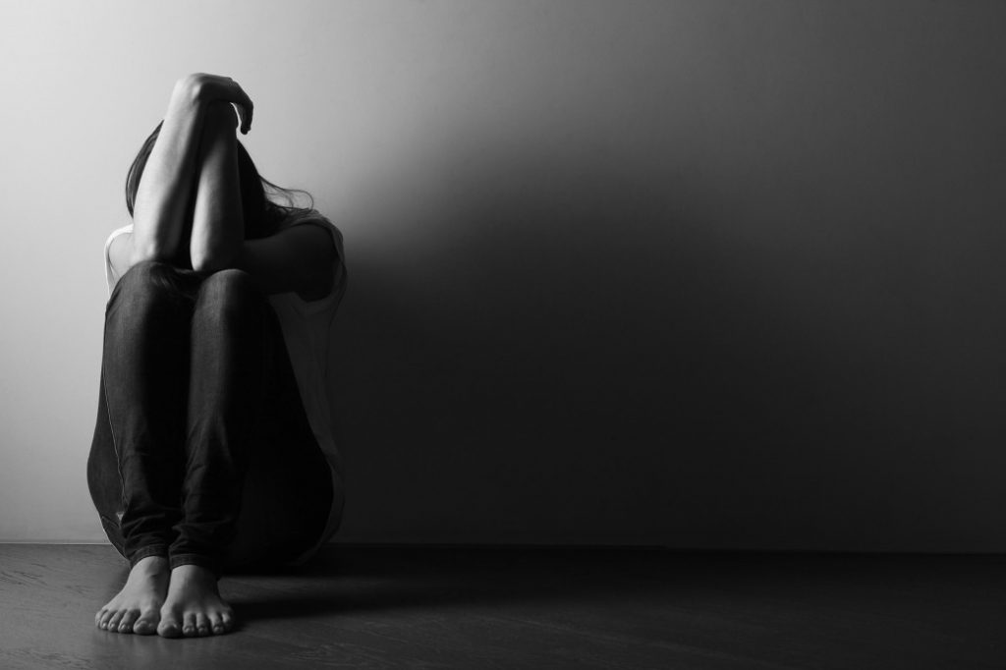

Slide 8
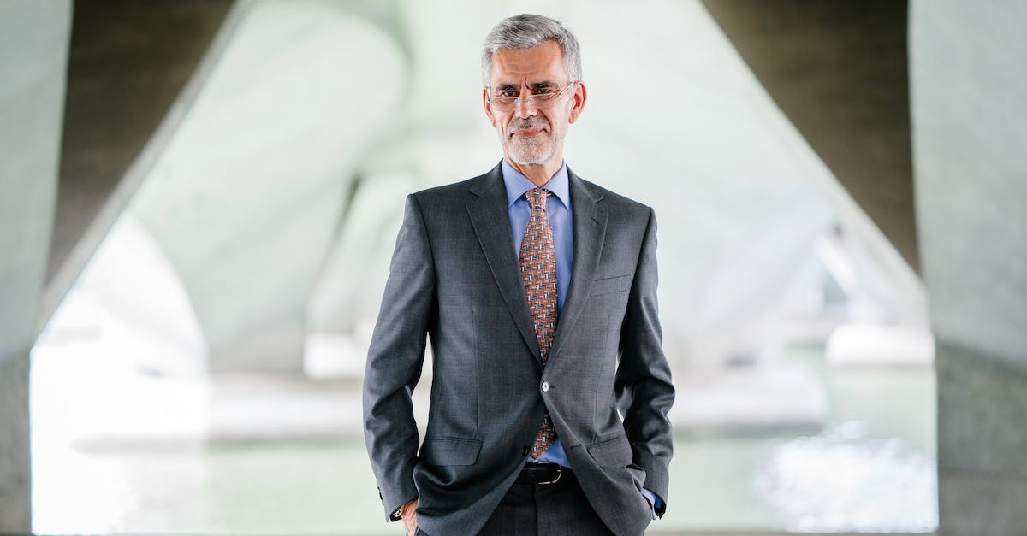

Slide 9
Who is poor in spirit?
Who thinks they need jesus?

Slide 10
Who more likely
To seek jesus?

Slide 11
^{Matthew 5:1-3}
5 Now when Jesus saw the crowds, he went up on a mountainside and sat down. His disciples came to him, ² and he began to teach them.
He said:
³ “Blessed are the poor in spirit, for theirs is the kingdom of heaven.

Slide 12
The leper...
Why could his friends not help him? An incurable disease that caused him to be in pain and also isolated him from his friends and family.
Why could he not help himself? Incurable disease.
Did Jesus have to help this man? No
How do we know this from what the man says to Jesus? Because the man acknowledges that Jesus would only help him if Jesus was willing to, in other words, if Jesus had mercy.
What two things showed the leper was “poor in spirit”? Because (1) he realised he had nowhere else to go except Jesus, and (2) he realised that he had nothing to offer Jesus.
Can we enter the kingdom by our own efforts? No
The leper...
Why could his friends not help him? An incurable disease that caused him to be in pain and also isolated him from his friends and family.
Why could he not help himself? Incurable disease.
Did Jesus have to help this man? No
How do we know this from what the man says to Jesus? Because the man acknowledges that Jesus would only help him if Jesus was willing to, in other words, if Jesus had mercy.
What two things showed the leper was “poor in spirit”? Because (1) he realised he had nowhere else to go except Jesus, and (2) he realised that he had nothing to offer Jesus.
Can we enter the kingdom by our own efforts? No

Slide 13
The leper...
Why could his friends not help him?
Why could he not help himself?
Did Jesus have to help this man?
How do we know this from what the man says to Jesus?
What two things showed the leper was “poor in spirit”?
Can we enter the kingdom by our own efforts? No
The leper...
Why could his friends not help him?
Why could he not help himself?
Did Jesus have to help this man?
How do we know this from what the man says to Jesus?
What two things showed the leper was “poor in spirit”?
Can we enter the kingdom by our own efforts? No

